Slide 1


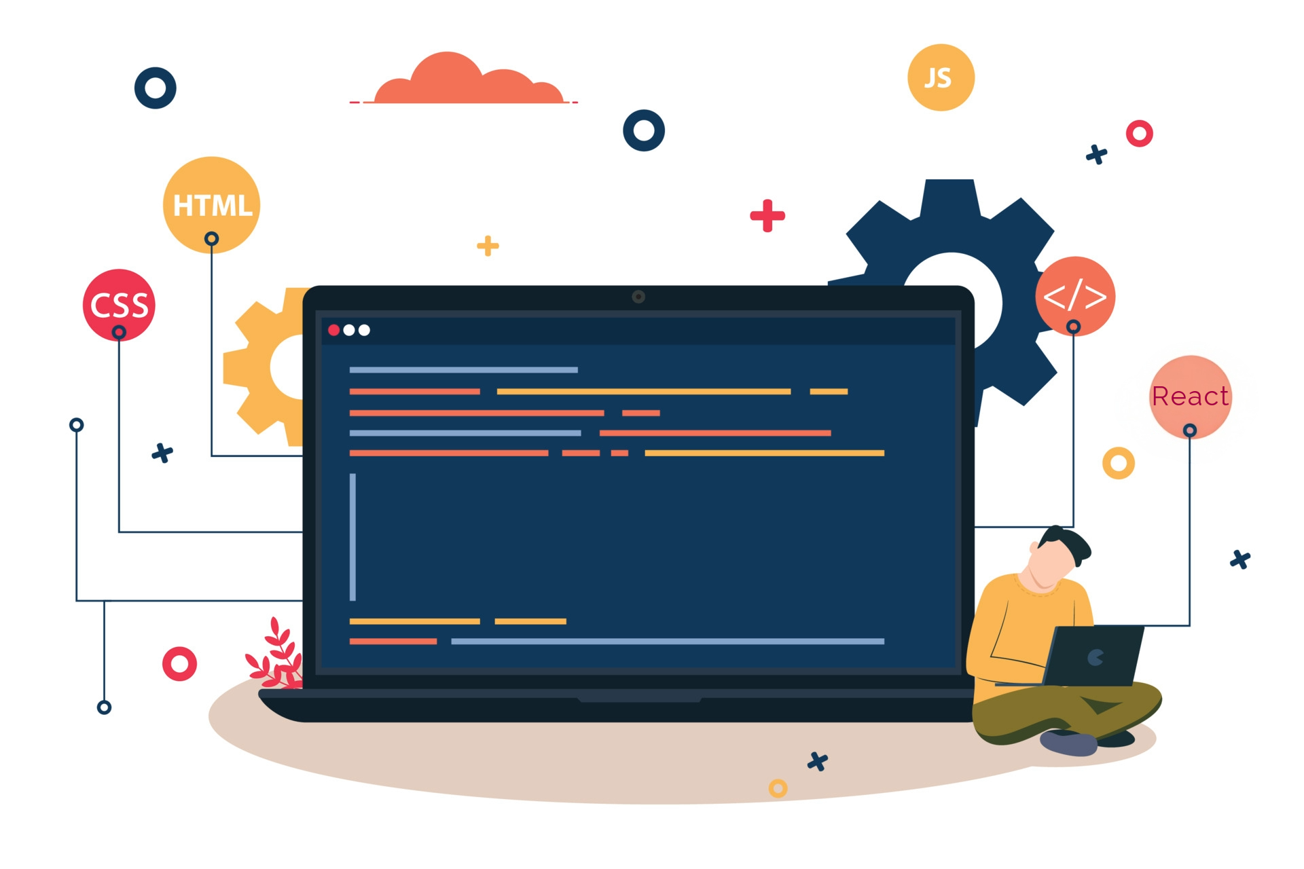



Lecture 35:
Prop Drilling
Course - Web Development - II
-By
Instructor Name
1
welcome@krmangalam.edu.in
Sohna Road,Gurugram,Haryana 122103

Slide 2

| Table of Contents
Prop drilling
References.
The End.
2

Slide 3

|
Have you ever played the game of Telephone/Whisper? One person whispers a message to the next, and it keeps passing through everyone until it reaches the last person. Do you think this is the right way of communication.
3

Slide 4
|
Have you ever played the game of Telephone/Whisper? One person whispers a message to the next, and it keeps passing through everyone until it reaches the last person. Do you think this is the right way of communication.
No, this is not the right way of communication. Because if some information is only meant for the 5th person, then passing it through 2nd, 3rd, and 4th is unnecessary.
They don’t need that data, yet they receive it. This can cause confusion, mistakes, or even loss of information along the way.
4

Slide 5
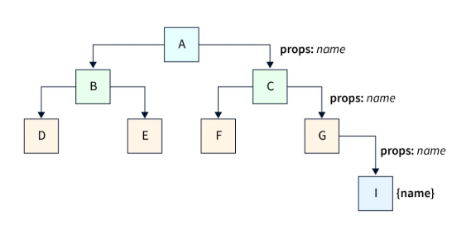
|
Have you ever played the game of Telephone/Whisper? One person whispers a message to the next, and it keeps passing through everyone until it reaches the last person. Do you think this is the right way of communication.
In React, this same problem happens when a piece of data (state/props) from a top component needs to be used in a deeply nested child.
To deliver it, every intermediate component has to receive and pass it along as props — even if those middle components don’t actually need it.
This unnecessary passing is called Prop Drilling.
5

Slide 6
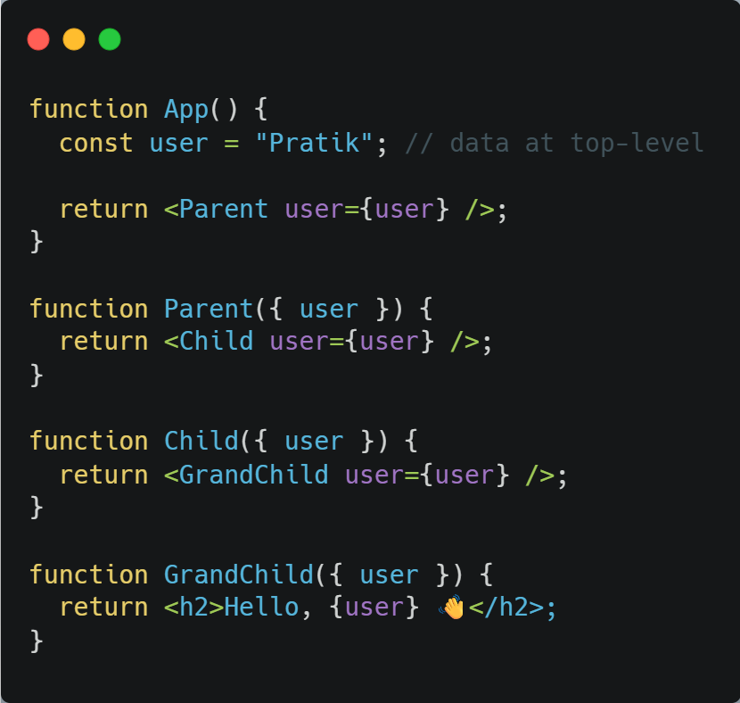
| Prop Drilling.
App
└── Parent
└── Child
└── GrandChild
Parent and Child don’t even use user, but still they have to receive and forward it. This is prop drilling.
user data is required only by GrandChild.
6

Slide 7
| Prop Drilling.
Why it's a problem:
Code Clutter & Verbosity: Components get filled with props they don’t need, just forwarding them. Makes code harder to read.
Refactoring is Hard: If you rename a prop or remove a middle component, you must update every layer.
Unnecessary Re-renders: Middle components re-render when props change, even if they don’t use the data. This impacts performance.
It’s just like the Telephone Game — people in the middle don’t care about the message, yet they’re forced to handle it.
7

Slide 8

| Coding Questions
1. Prop Drilling Example
Task :
Create a three-level component tree (App -> UserDetails -> UserGreeting). Pass a user object from App all the way down to UserGreeting to be displayed. This will demonstrate the problem of prop drilling.
8

Slide 9
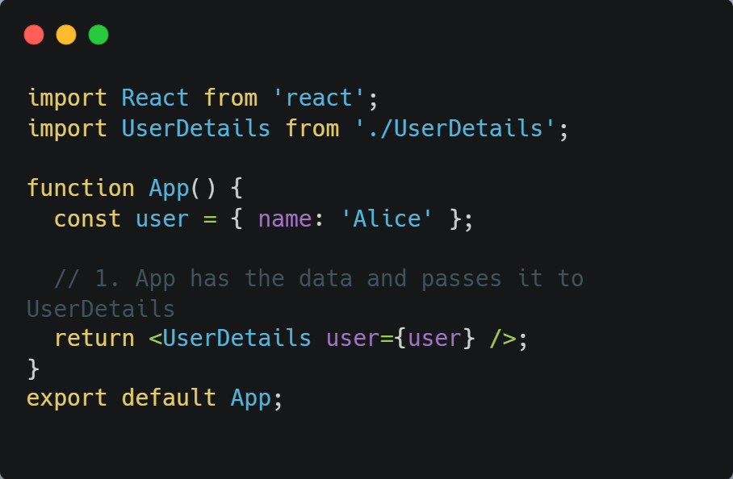
| Coding Questions
Solution :
src/App.jsx:

Slide 10
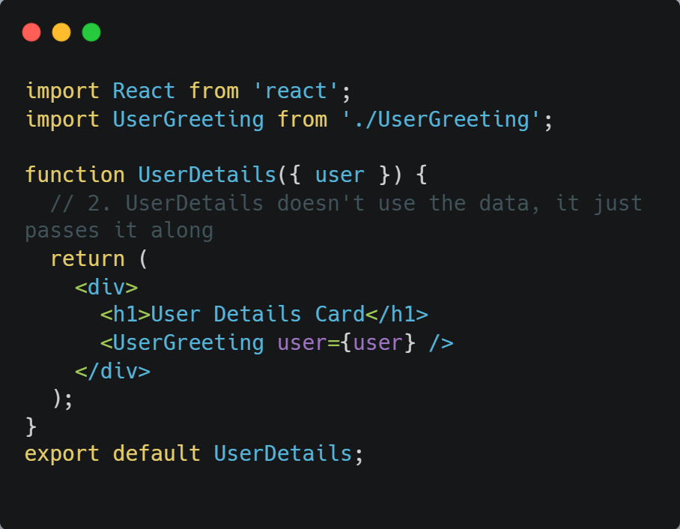
| Coding Questions
Solution :
src/UserDetails.jsx:

Slide 11
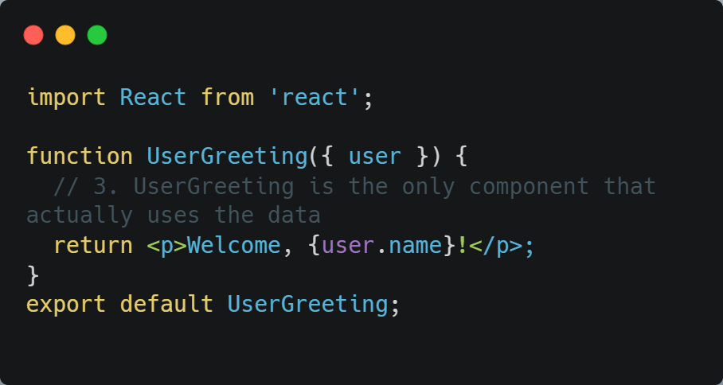
| Coding Questions
Solution :
src/UserGreeting.jsx:

Slide 12
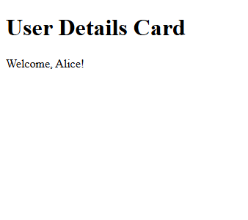
| Coding Questions
Output :

Slide 13
| References
MDN Web Docs : Comprehensive and official documentation for JS. 🔗https://developer.mozilla.org/en-US/docs/Web/JavaScript
W3Schools – JS Tutorial : Beginner-friendly JS tutorials with examples and interactive editors. 🔗 https://www.w3schools.com/js/
react.dev - A comprehensive, tutorial-style website that deeply explores core React concepts, including components, state, effects, and hooks, through interactive examples and in-depth explanations.
🔗https://react.dev/

Slide 14
Thanks
For
Watching
Course - Web Development - II
welcome@krmangalam.edu.in
Sohna Road,Gurugram,Haryana 122103

